Slide 1


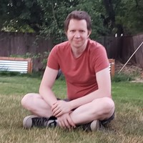




Speaker
Justin Grote
Presto Pester! Effective Powershell Testing with VSCode
Justin Grote
justinwgrote
September 16th & 17th
^{Online Event}
Powered By
International Conference

